Slide 1
Human Frontier Science Program
International Collaboration
in Life Sciences Research

Slide 2
Human Frontier Science Program
Established in 1989
Supported by:
Australia, Canada, France, Germany, India, Italy, Japan, Republic of Korea, Norway, New Zealand, Singapore, Switzerland, United Kingdom, United States of America and European Commission
Headquarters in Strasbourg, France (www.hfsp.org)
Annual budget: ~ USD 57M

Slide 3
Human Frontier Science Program
HFSPO promotes and funds basic research
innovative, cutting edge research to extend the frontiers of life sciences
focused on the elucidation of the sophisticated and complex mechanisms of living organisms
HFSPO attaches the highest importance to
scientific merit
internationality (especially intercontinentality) and
interdisciplinarity

Slide 4
Human Frontier Science Program
Funding Schemes

Slide 5
Human Frontier Science Program
Research Grants for Intercontinental Teams
Collaborations to pursue creative, transformative research ideas
Young Investigator Grants
Program Grants
Postdoctoral Fellowships
Long Term Fellowships - for the most able postdocs in the life sciences
Cross Disciplinary Fellowships – for the most able postdocs in non-biological sciences
Career Development Awards
For recent HFSP Fellows

Slide 6
Human Frontier Science Program
Research Grants
Summary
(check details at www.hfsp.org)

Slide 7
Research Grants: Objectives
Stimulate novel, daring ideas and innovative approaches
frontier research on the complex mechanisms of living organisms
all levels of biological complexity
preliminary results not required
Develop new lines of research through new interdisciplinary collaborations
Team members from outside the life sciences,
working together on bold, novel, potentially transformative ideas

Slide 8
HFSP Research Grants
Program Grants
teams of 2-4 scientists (rarely 5)
international (preferably intercontinental)
interdisciplinary
at any stage of careers (often in 30s and 40s)
Young Investigator Grants
as above, but all team members
within 5 years of their first independent position
not more than 10 years after Ph.D.
Deadlines
Letters of intent, mid March
Invited full applications, early September

Slide 9
Research Grants – Key Aspects
Three year grants
Success rate
~ 4% of original Letters of Intent are funded, and
~ 10% are invited for submitting full applications
~ 40% from final review panel meeting
Funding
250 kUSD p.a. for a team of 2
350 kUSD p.a. for a team of 3
450 kUSD p.a. for a team of 4 (max. funds)

Slide 10
Research Grants – Key Aspects
Basic life sciences research
ranging from the molecular and cellular level to complex biological systems including higher cognitive functions and ecosystems
Investigator driven
no specific areas prioritised (the frontiers of life sciences change rapidly)
Emphasis on
participation of scientists from disciplines outside the traditional life sciences
scientists who are early in their careers
Highly competitive

Slide 11
Two Step Selection Process
1. Letter of intent
2. Full applications
Submission March/April (~900 appl.)
Not in scope triaged (~ 10%,)
Review by Review Committee members
Long short list (~300 most promising applications)discussed at meeting of the Selection Committee (June)
Invitations to 80 - 90 to submit full applications (early July)
Submission deadline mid-September
Reviewed by up to 6 external reviewers and by Review Committee members
Recommendations (~30) made at review committee meeting end of January
Approval by Board of Trustees (late March)
Committee members at www.hfsp.org

Slide 12
Developing an Application
Principal investigator must hold laboratory in one of HFSPO’s member countries
The team must be:
international and preferably intercontinental,
not have collaborated and published previously in this area of enquiry
Preliminary results not required

Slide 13
Developing an Application
Hints on making a strong application
Bring a totally new approach to your research problem
Describe how it is frontier-extending research
don’t shy away from risk though do argue that/how the ideas can work
Ensure each investigator is essential
teams of 2-3 (Young Investigator) and 2 – 4 (Program Grants) are more successful.
Show how the interaction between investigators

Slide 14
Developing an Application
Avoid:
routine research, “the next logical step”
applications that can be funded by your national research funding body
teams composed of existing collaborators
collaborations within a single country

Slide 15
Postdoctoral Fellowships
Summary
(check details at www.hfsp.org)

Slide 16
Postdoctoral Fellowshps
For top postdoctoral researchers proposing innovative, ground-breaking projects
Long-Term Fellowships
applicants with a biology Ph.D. to embark on a new project in a different field
Cross-Disciplinary Fellowships
Ph.D. from outside the life sciences e.g. physics, chemistry, mathematics, engineering or computer sciences

Slide 17
HFSP Postdoctoral Fellowships
General eligibility criteria
Work in a new country
Citizen of a HFSPO Member? Choose anywhere
Not from a Member country? Choose a lab in a Member country.
Apply within 3 years of Ph.D.
Must have one first-authorship paper
HFSP Fellowships

Slide 18
Conditions & Support
HFSP Fellowships
3 years
Living allowances
amount depends on the country; travel and possibly child and parental leave allowances
3rd year
can be back in home country
can be deferred for up to two years
~80 fellowships per year (success rate ~ 10%.)
Deadlines
Registration: mid August
Submission: late August

Slide 19
Developing an Application
HFSP Fellowships
A competitive fellowship application proposes a basic research project that
is creative, frontier, potential to be transformative
will introduce you to new fields, theory and methodology
HFSP Fellowships
Don’t propose a project
that is only an incremental step forward
that is a mainstream project in your host’s lab
in which there is no or minimal change in direction from your current and recent research
that fails to make clear your intellectual contribution

Slide 20
HFSP Fellowships
Career Development Award
Available only to former HFSP Long-Term and Cross-Disciplinary Fellows

Slide 21
Career Development Award
For recent HFSP Fellows to:
return to home country or to a HFSP Member Country
develop their independent frontier research program
Eligibility:
Completed at least 2 full years of HFSP Fellowship
Apply within 3 years after your HFSP Fellowship ends
Conditions & support:
300 k USD for 3 years
For research-related expenses (salaries of students/postdocs, reagents, etc.)
You must hold a salaried position allowing you to perform independent research
Success rate: ~16% (10 awards in 2017)
You can also apply for HFSP Young Investigator Grants and host HFSP Fellows

Slide 22
Out of scope for HFSP

Slide 23
Out of Scope
HFSPO does not support research projects that are:
Routine, not intellectually challenging, data collecting, observational studies
Research in for-profit environments (but collaboration possible)
Applied and translational research, such as :
Clinical trials, pharmaceutical development
Applied technology or applied engineering
Most environmental/ecological or agricultural research (unless about complex basic mechanisms of life)

Slide 24
Award Overview 1990 – 2017

Slide 25
Award Overview 1990 – 2017
Since 1990, HFSPO has supported:
7008 scientists throughout the world
1059 collaborative Research Grants involving 3902 scientists including 465 early career scientists through Young Investigator Grants
3079 postdoctoral Fellowships of ~70 nationalities
220 Career Development Awards

Slide 26
Award Overview 1990 – 2017
Previous Research Grant, fellowship and CDA awards
see
http://www.hfsp.org/awardees/awards-archive

Slide 27
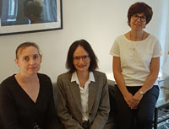
Contact
Secretary-General
Prof. Warwick Anderson
Fellowships/Career Development Awards fellow@hfsp.org Program/Young Investigator Grants
grant@hfsp.org
Website: www.hfsp.org
Sign up for HFSP Matters at: www.hfsp.org/newsletter
Warwick Anderson, Secretary General
Barbara Pauly, Director of Fellowships Geoff Richards, Director of Grants

Slide 28
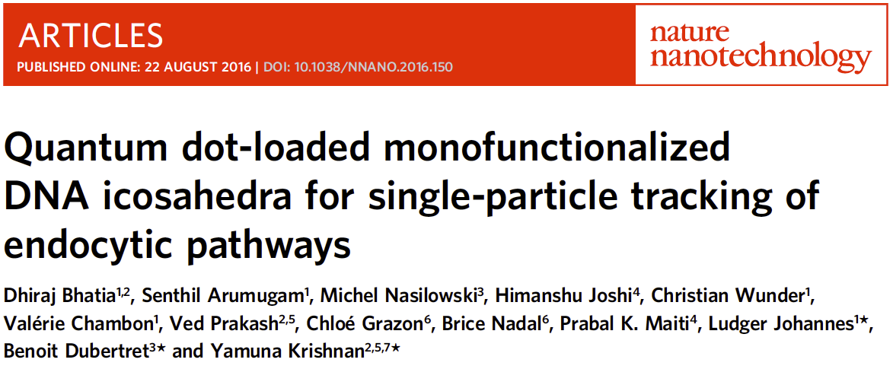
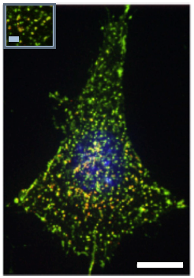
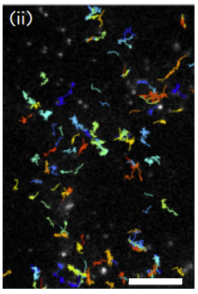
Examples of recent publications
Notes:
India, France, U.S.A.

Slide 29
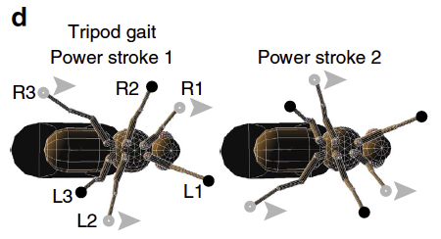
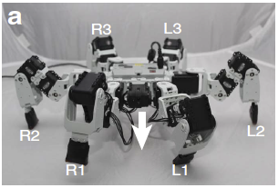
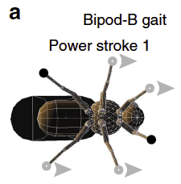
Examples
Notes:
Pavan Randya, Long term fellow, Switzerland, Now at CalTech.

Slide 30
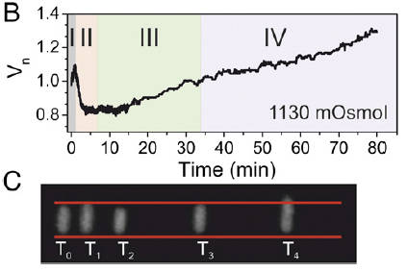
Examples
(2016) PNAS. 113, E5838–E5846
Notes:
U.K. China

