Slide 1
Human Frontier Science Program
Career Planning: Moving on - Funding your next big step after the postdoc
Guntram Bauer HFSP Awardees’ Annual Meeting July 1- 4, 2012
Daegu, Republic of Korea

Slide 2
Why This Workshop?
Many fellows are not fully aware of the flexibility for career planning that is inherent and unique to an HFSP fellowship
For example: Option for deferral (after the 2nd year) in combination with the third fellowship year
Being competitive at the time of the application for the CDA
The potential of the HFSP fellowship
Planning towards your CDA application
The philanthropic funding landscape

Slide 3
HFSP „Early Career Support“
$: NSF, NIH,...
£: BBSRC, MRC,..
€: DFG, CNRS,...
⇒ EMBO (Europe)
New country
EMBO
LTF 1-2
Deferral
LTF3
3
6
9
12
Time since Ph.D. (Years)

Slide 4
Fellow – CDA Transition
The CDA is not the best paid in this category but it buys time and helps to close a funding gap
Already as an HFSP fellow you carry “the badge” of distinction; the CDA may help you even further (feedback from previous CDA holders)
The CDA, just like the HFSP Research Grant, is meant as seed money to establish your first laboratory and to embark on a novel line of research. Funds may not be sufficient to support your entire laboratory.
Identify additional sources for funding early and devise a strategy for proposal writing (Be aware of different program philosophies)

Slide 5
HFSP „Early Career Support“
New Rule: Move to a different HFSP member country
HFSP Grant
New country
HFSP CDA
LTF 1-2
Deferral
LTF3
3
6
9
12
Time since Ph.D. (Years)

Slide 6
Fellow – CDA Transition
New Rule: HFSP Fellows are eligible to apply for the HFSP Career Development Award (CDA) if they establish their first independent laboratory in one of the HFSP member countries
Tenure of up to 3 years; the 3rd fellowship year can be used in the original host lab or after moving to a different HFSP member country; in this case it can be deferred for up to two years
The mobility aspects remains: mandatory change of country for the CDA!
The selection of the CDA’s is as stringent and competitive as other HFSP Programs

Slide 7
The CDA application
Timing of your application is crucial: submit when you have something to show for (fellowship results)
Since AY 2012 each applicant can apply twice for the CDA!
Discuss the finance with your institution ahead of time to avoid delays and unexpected surprises (fund management)
To become an HFSP fellow you had to change direction (selection criteria): highlight your success in the new field when interviewing or submitting grants
Problem: research project vs. research program
Set up your own scientific website with up-to-date publication output and ongoing (or planned) research projects

Slide 8
Good & Bad Ideas
A successful (HFSP) project...
is an original study at the frontiers of life sciences that may evolve out of the fellowship or even breaks new ground.
is deemed to make a major contribution to the field
contains elements of international collaboration
The proposal for the CDA should fit with the transformational, frontier, potentially risky, ambitious vision of HFSP.

Slide 9
Good & Bad Ideas
CDA applications are reviewed less favourably because:
the proposal represents mainstream research (likely to be funded through national programs)
the proposal is a direct continuation of the fellowship project w/o any new elements
the research program is far too ambitious for a start-up laboratory of a young investigator over three years or too simplistic in its approach (observational)
the applicant intends to return to the PhD lab

Slide 10
The Funding Landscape
Competition for CDA type grants intensifies as the number of awards in this category (from HFSP and other sources) decreases
Your opportunities increase if you consider research agency and philanthropic grants
Become an expert for your country/region/field
Most academic centers have administrative units that can advise on grant initiatives and funding opportunities
Use exhibition areas during conferences to make personal contact to representatives of funders

Slide 11
Philanthropic Grants
Private foundations/trusts
Often support a specific theme or niche („off the beaten track“)
Target a highly specialized group of applicants (e.g. rare disease)
Funds may be used in a more flexibility way
Try to become a host supervisor for stipend funded PhD students & postdocs
Potential trade offs:
Funding volume is small and targeted!
Prestigious, hence highly competitive!
Program portfolio may change often (3-5 years)

Slide 12
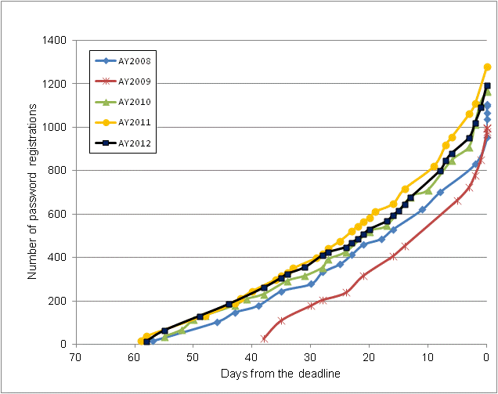
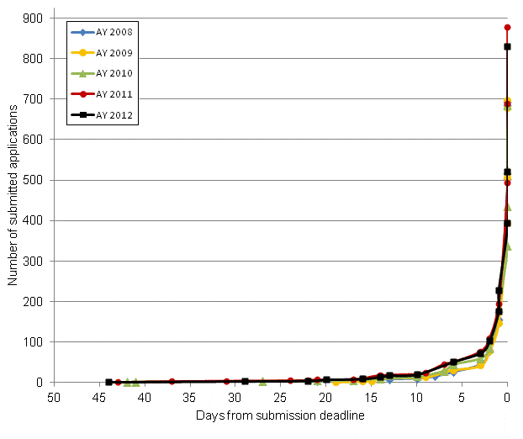
Don’t be late with submission!
Scientists are creatures of habit!
HFSP fellowship registration & submission for AY 2008-2012

Slide 13
Thank you
Contact:
Human Frontier Science Program 12 quai Saint-Jean 67080 Strasbourg
Email: fellow@hfsp.org Web: www.hfsp.org

